Slide 1
Jurassic Park Project
UBMS Stem Experience

Slide 2


Jurassic Park Project

Slide 3
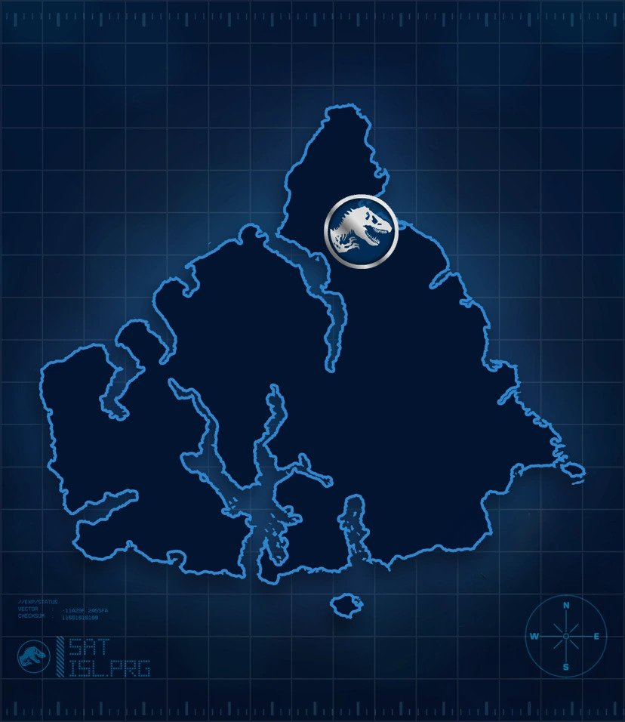
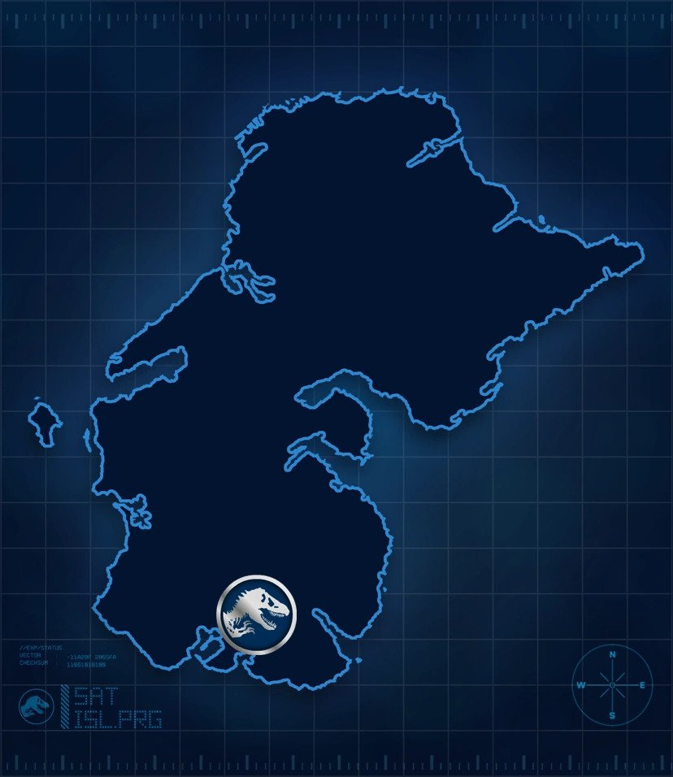

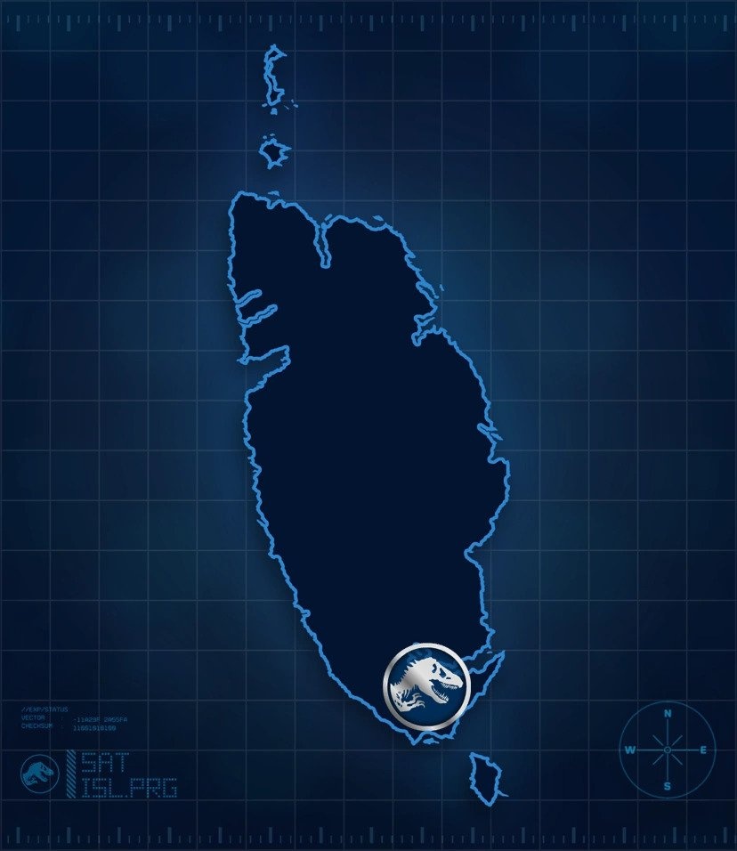

Las Cinco Muertes

Slide 4
Island Networks

Slide 5
Island Design

Slide 6
Building Computers

Slide 7
Making Connections

Slide 8
Creating Servers

Slide 9
Building a Network

Slide 10
Becoming Hackers

